Slide 1
EDAI2 PROJECT - PPT FOR END SEMESTER ASSESSMENT - 10th JUNE 2023
SPEECH EMOTION RECOGNITION & MUSIC RECOMMENDATION
Div:-
A
EDAI2_GROUP No :-
2
Day :-
Saturday
Date :-
10-06-2023
Presented by
Project Guide
Sairaj Abnave (12210063)
Aditya Adaki (12210428)
Swapnil Adake (12210225)
Amit Adhav (12210890)
Aditi Bhat (12210197)
Aditya Bansul (12210384)
Prof. Anita B. Dombale
DEPARTMENT OF ENGINEERING SCIENCES AND HUMANITIES (DESH)
VISHWAKARMA INSTITUTE OF TECHNOLOGY, PUNE

Slide 2
Introduction
Our decided project for this term is Speech Emotion Recognition system. We will be using python as language tool for this project. Our aim for this project is to make a system that will take human speech as input and on the basis of the database so provided, it will give the most desired emotion as its output and as an additional functionality, on basis of the emotion so recognized, a song will be recommended to the user.

Slide 3
Objectives
Develop a system for speech emotion recognition and music recommendation.
Extract speech features and classify emotions.
Map emotions to suitable music genres.
Provide personalized music recommendations using collaborative filtering and content-based methods.
Enhance user experience with emotionally aligned music suggestions.

Slide 4
Speech dataset with annotated emotion labels
Music dataset
Machine learning framework
Development environment and software tools
Materials

Slide 5
Speech signal processing module
Emotion recognition model
Music recommendation engine
User interface for interaction and feedback
Database for storing speech and music data
Components

Slide 6
Python programming language.
Jupyter Notebook
Pandas for data manipulation.
NumPy for scientific computing.
Multilayer perceptron Neural Network
Tools

Slide 7
Methodology
Gather speech datasets, process them and extract relevant features from them
Train the speech emotion recognition as well as the music recommender model on respective datasets.
Integrate the two models that will take speech input and provide personalized music recommendations based on the user's emotional state.
Evaluate the integrated system using appropriate evaluations metrics.
Refine and optimize the models including improving the extraction methods etc.
Deploy the integrated system to make it user interactive and maintain the system.

Slide 8
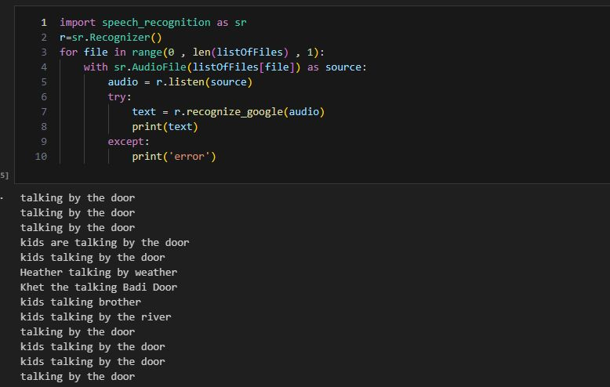
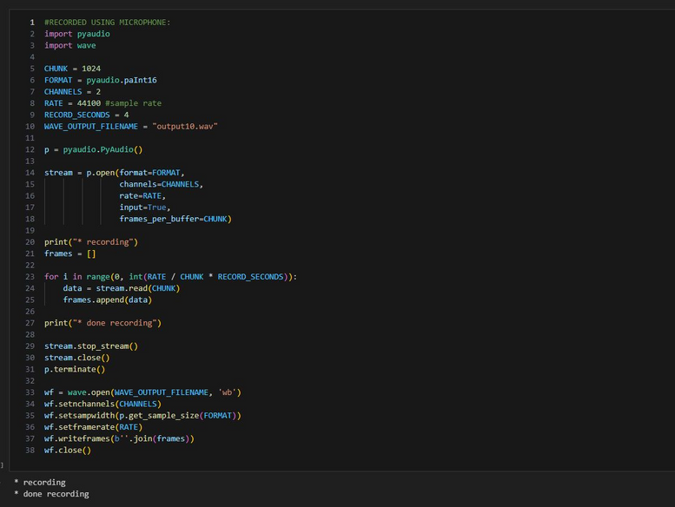
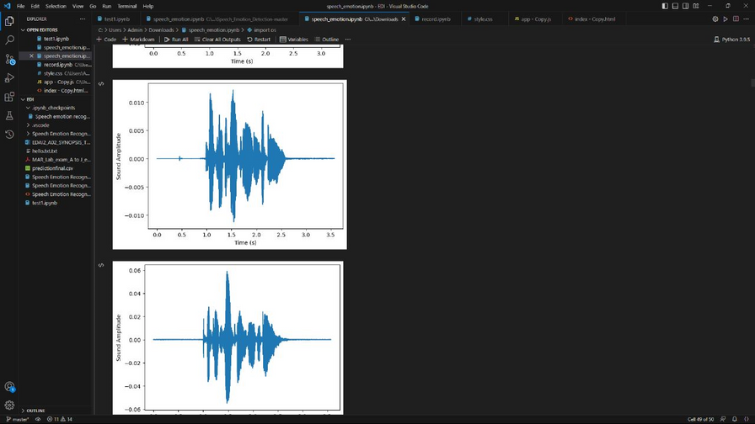
Testing snaps

Slide 9
Results and Discussions
Evaluation of emotion recognition accuracy and performance metrics.
Analysis of the effectiveness of different machine learning models for emotion classification.
Assessment of the music recommendation system's accuracy and user satisfaction.
Examination of the impact of integrating speech emotions on music recommendation quality.
Discussion on the potential for enhancing user experience through emotionally aligned music suggestions.

Slide 10
Future Scope
Exploration of advanced emotion recognition techniques, such as using multimodal data or transfer learning.
Incorporation of real-time emotion detection for dynamic music recommendation.
Integration of user feedback and preferences to continuously refine the recommendation system.
Application of natural language processing for better understanding user context and emotions.
Expansion of the system to support multiple languages and cultural preferences.

Slide 11
Thank you!

